Slide 1
Chapter 11: Cell Signaling & Communication
Cells respond to signals
Physical: light/heat
Chemical : hormones/neurotransmitters
They must have a SPECIFIC receptor for the signal to cause a response

Slide 2
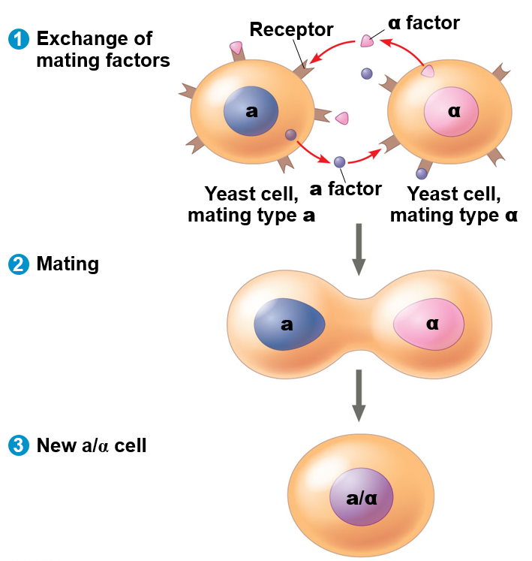
External signals cause responses
EX: One type of communication is in regards to sex
The yeast (fungi) Saccharomyces cerevisiae has two mating types, a and α
What are the benefits of this?
How does this work?
Signal Transduction Pathway!
Involves: signal, receptor, and a response

Slide 3
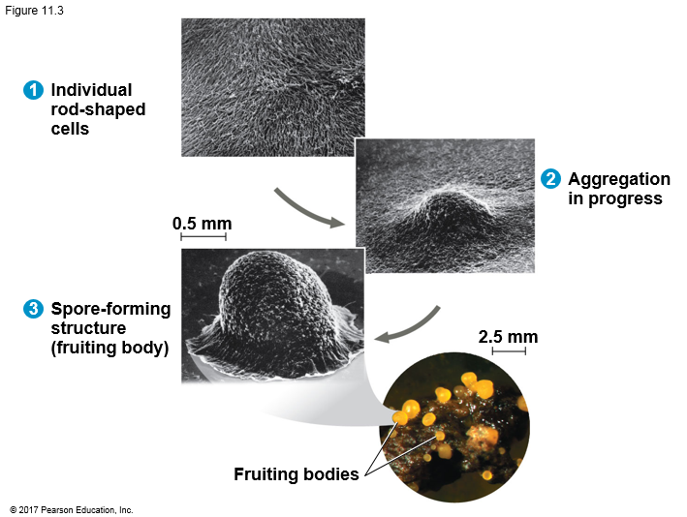
Bacteria communicate too!
Secrete molecules that can be sensed
Quorum sensing- coordinate behaviors
Biofilm
Teeth, fallen log,
Secretion of toxins by infectious bacteria
Treatment?: Interfere with cell signaling; alternative to antibiotics
When resources are low- sense density and form spores when needed

Slide 4
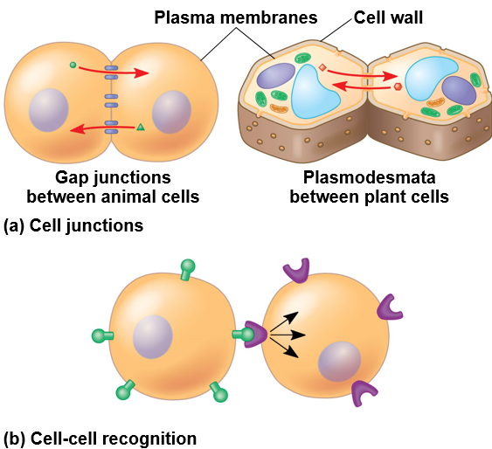
Signaling: Local and Long Distance
Communicate through:
Self-Signaling (autocrine)
Cell signals itself to release something
Ex: Cancer cell producing its own growth factor
Local Signaling (juxtacrine and paracrine)
Direct Contact (no distance) “Juxtacrine” (pass a note)
Cell Junctions (cytoplasmic)
Cell-Cell recognition
Both very important for embryonic development and immune system

Slide 5
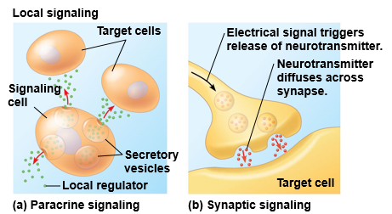
Local Signaling (autocrine and paracrine)
Close Contact (short distance) “Paracrine” (Send an email)
Paracrine signaling : acts on nearby cells and uses local regulators
Synaptic Signaling : synapse then target cell (neurotransmitter)

Slide 6
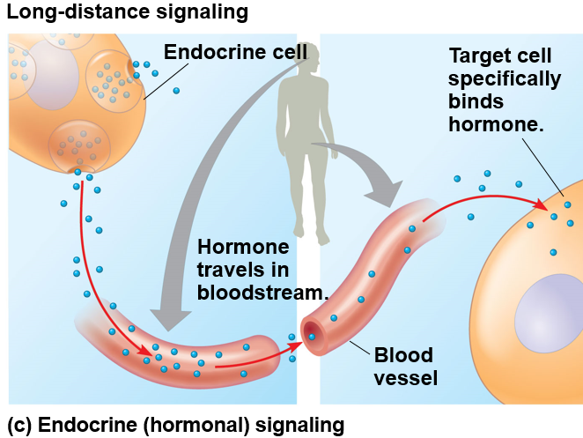
Long Distance Signaling
Endocrine Signaling (Post Status Update)
Hormones (wide variety)
Animals - circulatory system
example- insulin for sugar regulation in blood is a protein with thousands of atoms
Plants - vascular system or cell to cell
example- ethylene for ripening only 6 atoms C₂H₄

Slide 7
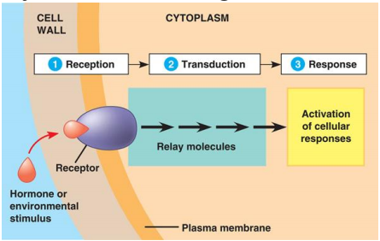
11.2-11.4 Signal Transduction Pathway in Animals
3 Stage Process:
Reception, chemical signal to target cell causes receptor protein to change
Transduction, receptor protein changes which initiates transduction process
Response, cell does something because of transduction
Short term response- open an ion channel
Long term response- gene expression
A key to maintaining homeostasis!

Slide 8
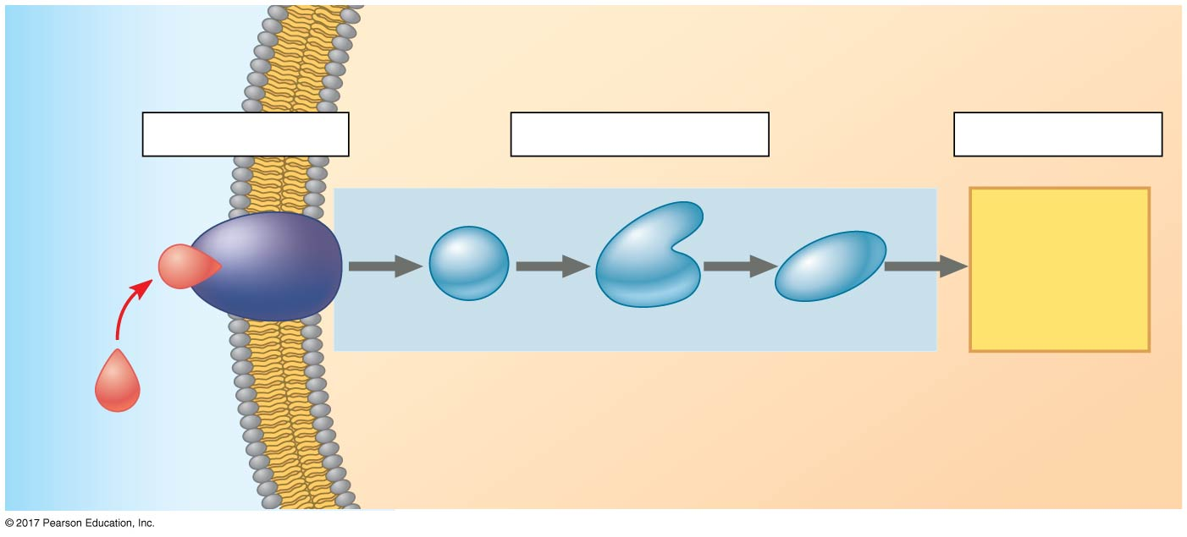
Figure 11.6_3
EXTRACELLULAR
FLUID
CYTOPLASM
Plasma membrane
1
Reception
2
Transduction
3
Response
Receptor
Activation
of cellular
response
1
2
3
Relay molecules
Signaling
molecule
Notes:
Figure 11.6_3 Overview of cell signaling (step 3)

Slide 9
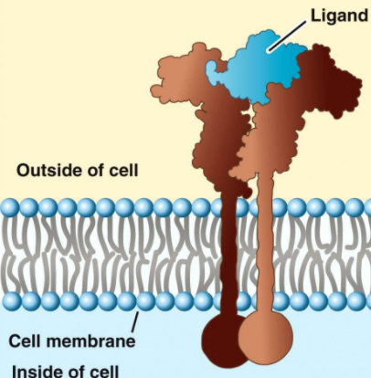
11.2 Reception
Signaling molecule (Ligand) binds to specific receptor on cell and causes shape change
Reversible
Inhibitors (antagonist) can block

Slide 10
Receptors are classified by location and activity
Location
Cytoplasmic receptors- have small nonpolar ligands, can diffuse across membrane
Membrane receptors- large or polar ligands (ex insulin) that can’t diffuse

Slide 11
Membrane Receptors
Receptor tyrosine kinase proteins
G Protein-linked receptor
Ion channel receptors

Slide 12
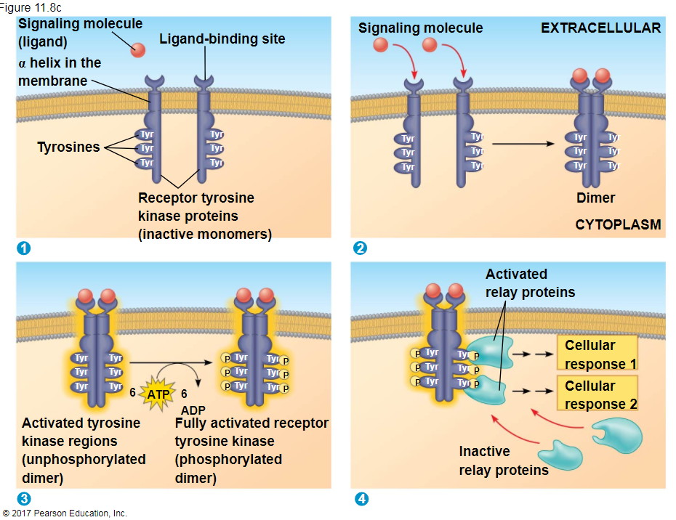
Membrane Receptors
Receptor tyrosine kinases (RTKs) are membrane receptors that transfer phosphate groups from ATP to another protein
can trigger multiple signal transduction pathways at once
Abnormal functioning of RTKs is associated with many types of cancers

Slide 13
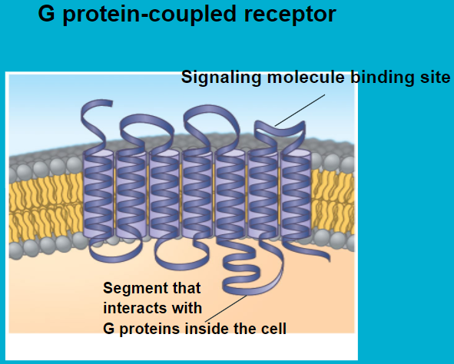
G protein-linked (coupled) receptors: GPCR
Cell surface transmembrane receptors work with G protein
G Protein binds to energy rich GTP (guanosine triphosphate)
Very diverse in function
3 subunits
Receptor
GDP and GTP (energy transfer)
An effector protein- cause response

Slide 14
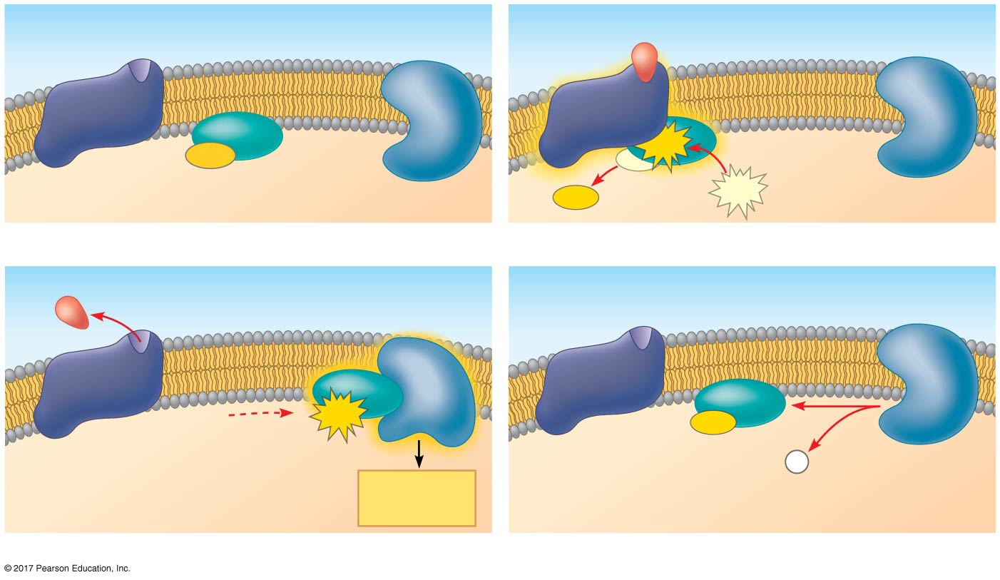
Figure 11.8b
G protein-coupled
receptor
Plasma membrane
Activated
receptor
Signaling
molecule
GDP
GTP
G protein
(inactive)
Inactive
enzyme
Enzyme
GDP
GTP
1
2
Activated
enzyme
EXTRACELLULAR
GTP
GDP
P
i
Cellular
response
CYTOPLASM
3
4
Notes:
Figure 11.8b Exploring cell-surface transmembrane receptors (part 2: GPCR signaling)

Slide 15
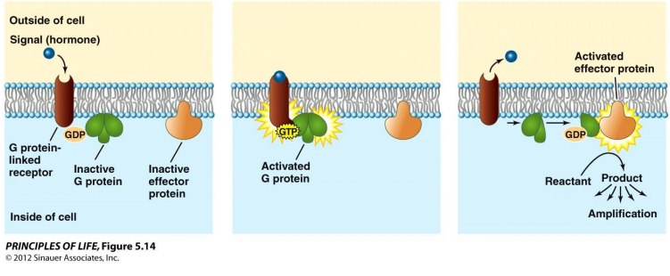

Slide 16
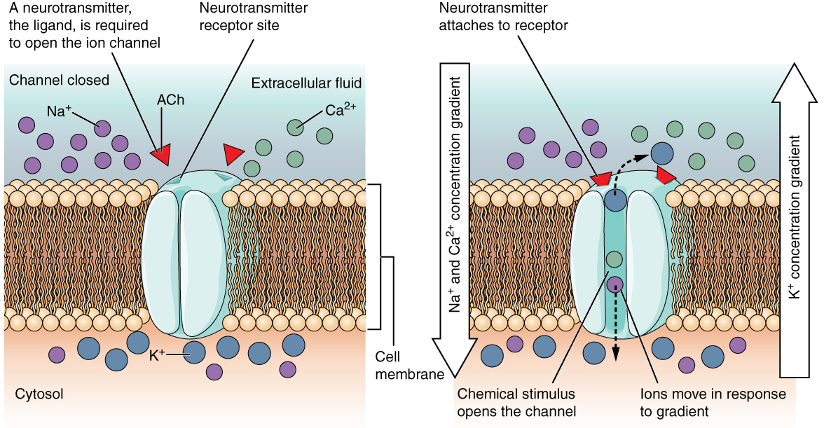
Ion channel receptors- gated ion channels change shape with binding of ligand
Ex acetylcholine receptors
Nicotine mimics

Slide 17
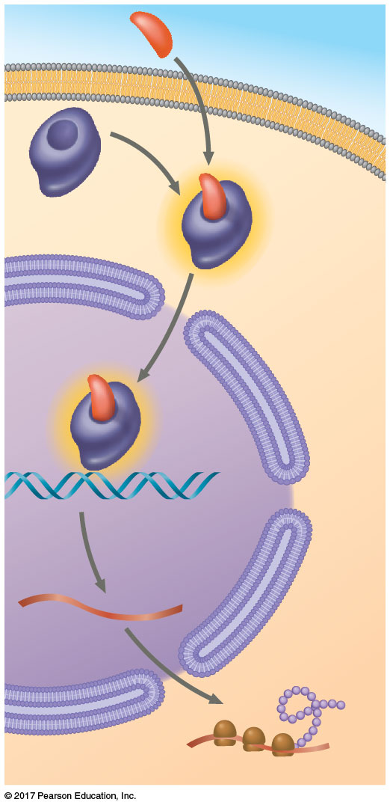
Intracellular Receptors
EXTRA-
CELLULAR
FLUID
Plasma
membrane
Found in the cytoplasm or nucleus of target cells
Small or hydrophobic chemical messengers
Examples: steroid and thyroid hormones of animals
An activated hormone-receptor complex can act as a transcription factor, turning on or off specific genes
Hormone
(aldosterone)
Receptor
protein
Hormone-
receptor
complex
DNA
mRNA
New
protein
NUCLEUS
CYTOPLASM

Slide 18
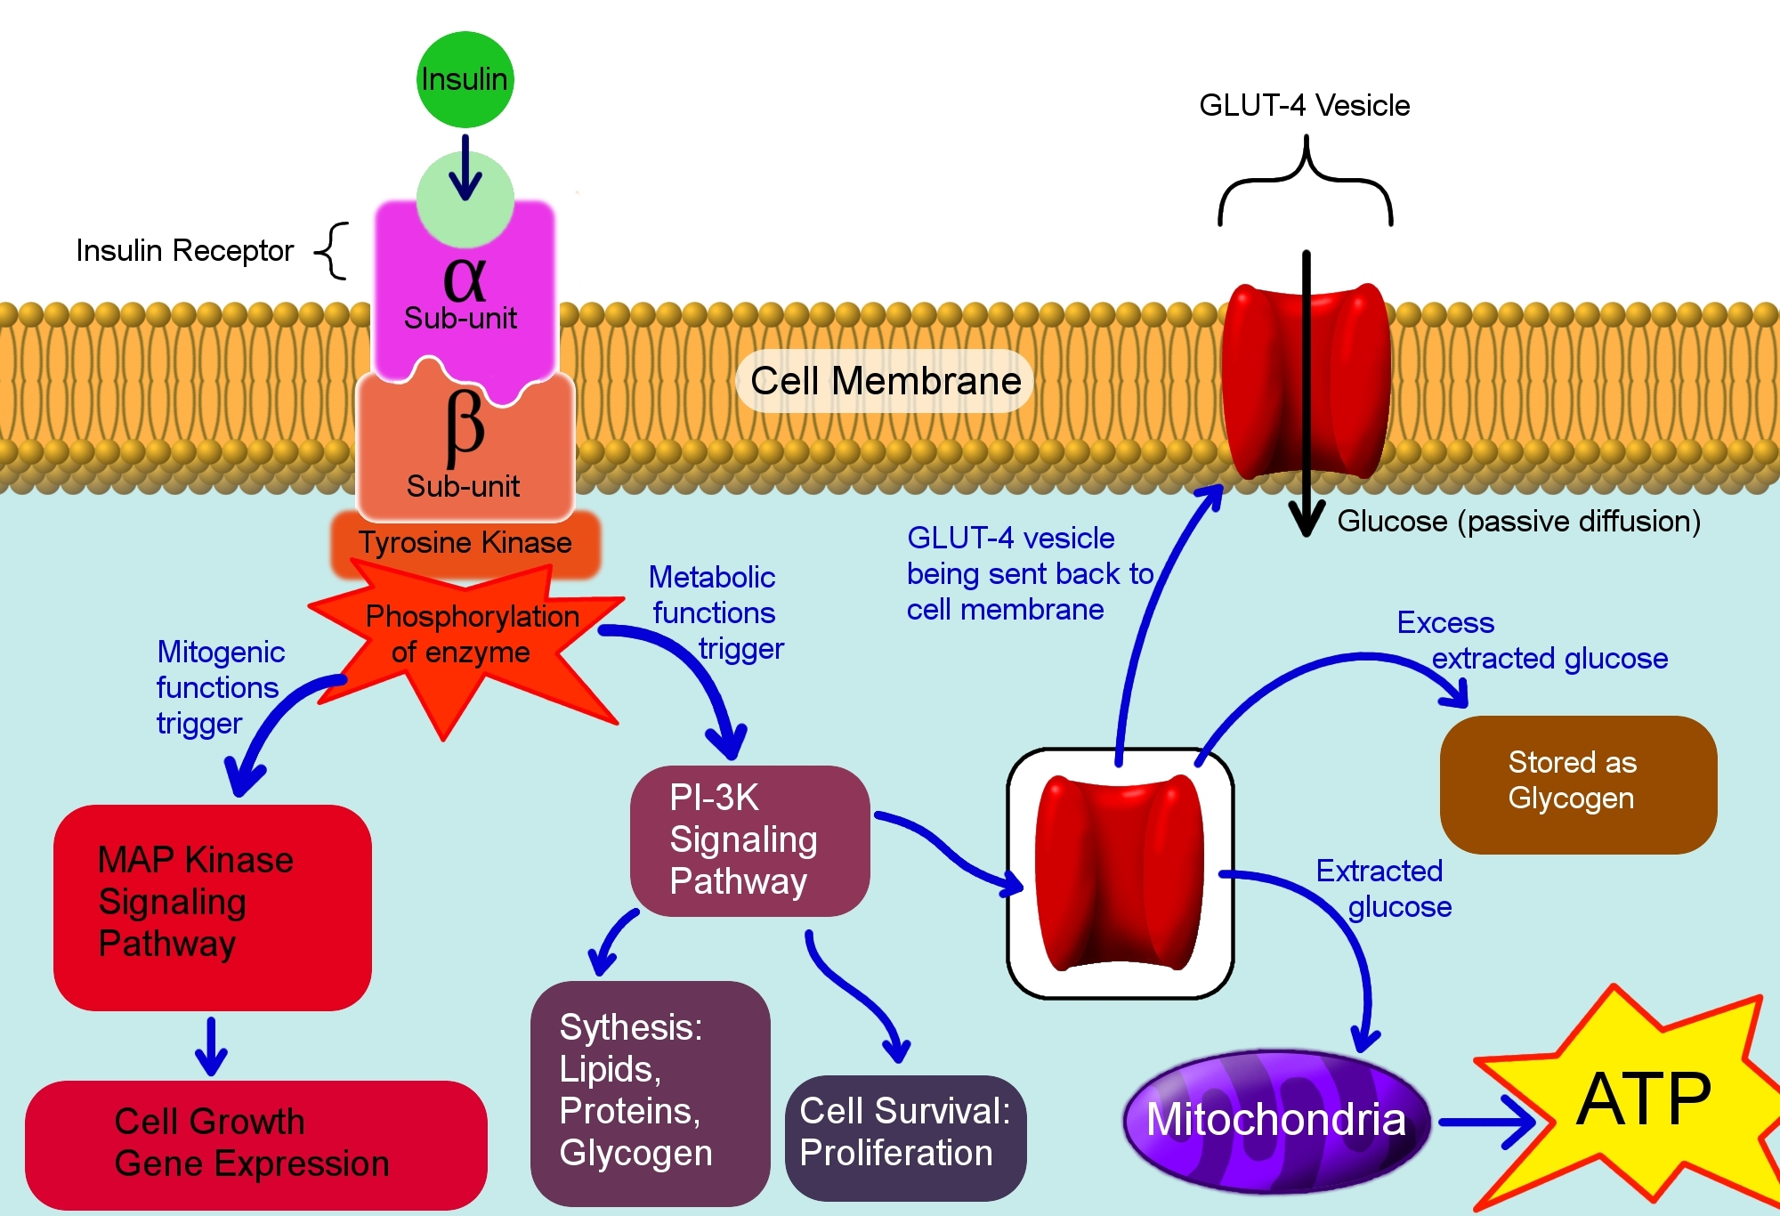
Concept 11.3: Transduction:
Cell signaling is usually a multistep process
greatly amplify a signal
provide more opportunities for coordination and regulation of the cellular response

Slide 19
Signal Transduction Pathways
Binding to receptor triggers the first step in a chain of molecular interactions
The receptor activates another protein, which activates another, and so on
“Dominos”
Example: “Fight or Flight”- in liver cells, a signal cascade begins when epinephrine stimulates a G protein-mediated protein kinase pathway

Slide 20
Signal transduction ends after the cell responds, enzymes convert each transducer back to its inactive precursor
Balance between regulating enzymes and the signal enzymes determines the cell’s response

Slide 21
Epinephrine
Bozeman 2:23-9:14

Slide 22
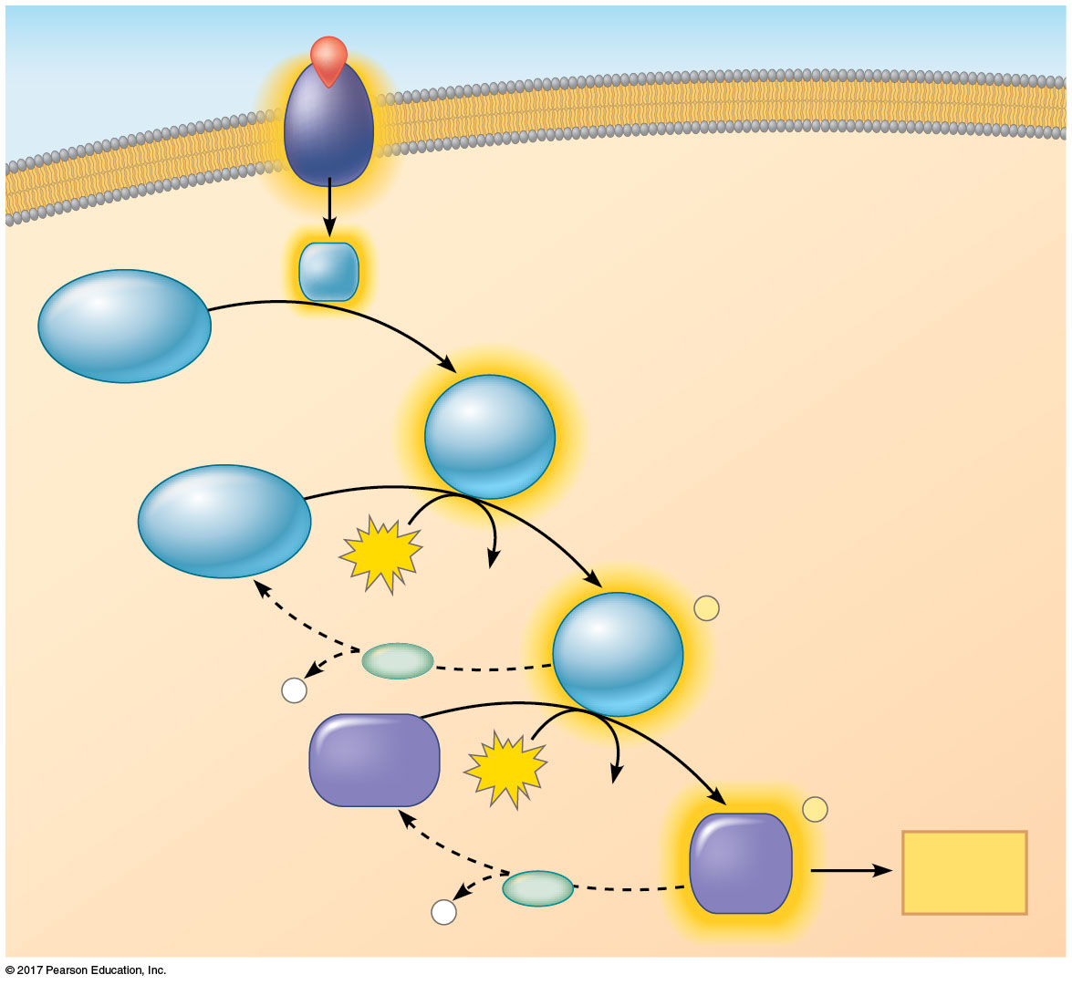
Figure 11.10
Signaling molecule
Activated relay
molecule
Receptor
Inactive
protein kinase
1
Active
protein
kinase
Inactive
protein kinase
1
Phosphorylation cascade
2
ATP
ADP
Active
protein
kinase
P
PP
P
i
2
Inactive
protein
ATP
ADP
P
Active
protein
Cellular
response
PP
P
i
Notes:
Figure 11.10 A phosphorylation cascade

Slide 23
Concept 11.4: Response
The signal is amplified and distributed
Causes different responses
The cell’s response to an extracellular signal is called the “output response”
Second messengers, such as cAMP
Amplify by activating multiple enzyme targets
Distribute the signal with many events inside the cell

Slide 24
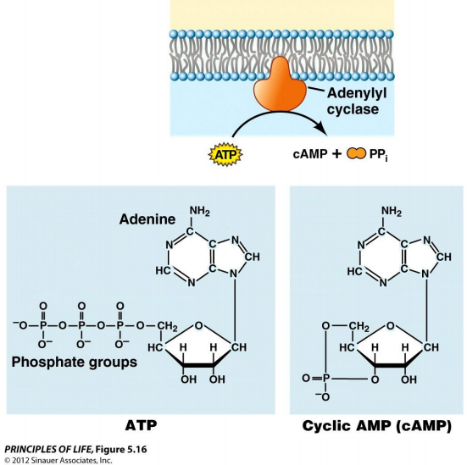

Slide 25
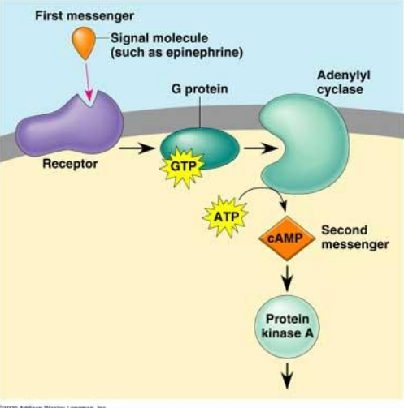

Slide 26
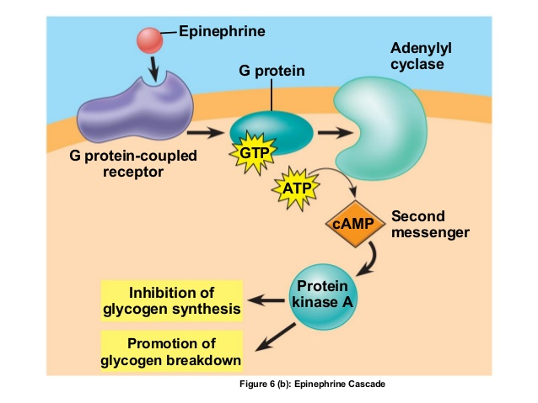

Slide 27
Nuclear and Cytoplasmic Responses
Ultimately, a signal transduction pathway leads to regulation of one or more cellular activities
The response may occur in the nucleus or in the cytoplasm
Many signaling pathways regulate the synthesis of enzymes or other proteins, usually by turning genes on or off in the nucleus
The final activated molecule in the signaling pathway may function as a transcription factor

Slide 28
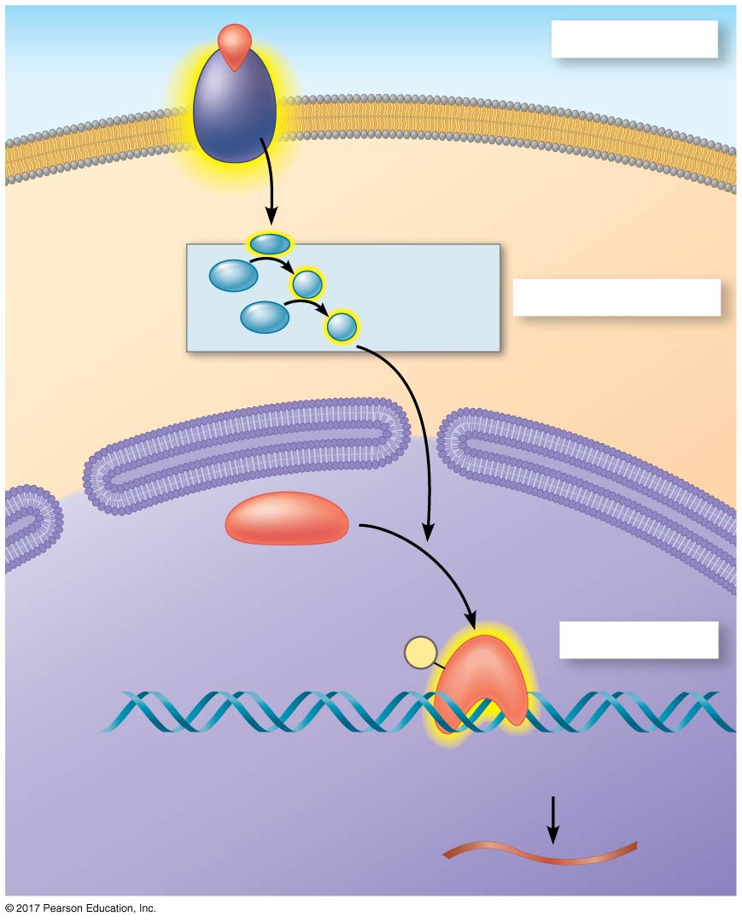
Figure 11.15
Growth factor
Reception
Receptor
Phospho-
rylation
cascade
Transduction
CYTOPLASM
Inactive
transcription
factor
Active
transcription
factor
P
Response
DNA
Gene
NUCLEUS
mRNA
Notes:
Figure 11.15 Nuclear responses to a signal: the activation of a specific gene by a growth factor

Slide 29
Other pathways may regulate the activity of enzymes rather than their synthesis
For example, a signal could cause opening or closing of an ion channel in the plasma membrane or a change in cell metabolism

Slide 30
Signaling pathways can also affect the overall behavior of a cell; for example, a signal could lead to cell division

Slide 31
11.5: Apoptosis “programmed cell death”
Cells that are infected, damaged, or at the end of their functional lives (damaged DNA or misfolded proteins)
Vesicles
Apoptosis prevents enzymes from leaking out of a dying cell and damaging neighboring cells
Apoptosis leads to destruction of the internal structures of the cell and “chopping” up its DNA etc.

Slide 32
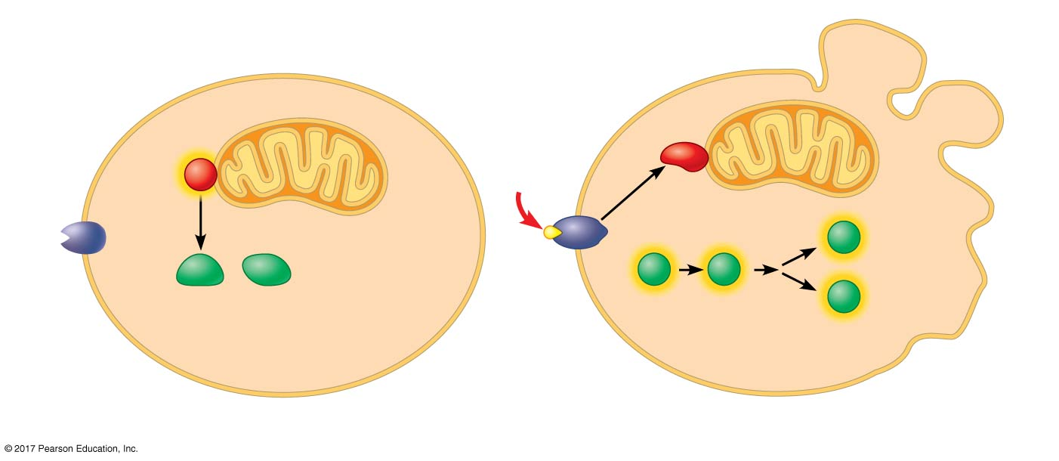
Figure 11.20
Active Ced-9 protein
inhibits Ced-4 activity.
Inactive Ced-9 does
not inhibit Ced-4.
Cell
forms
blebs
Mitochondrion
Death-
signaling
molecule
Active
Active
Ced-4
Ced-3
Nucleases
Receptor
for death-
signaling
molecule
Other
proteases
Ced-4
Ced-3
Activation
cascade
Inactive proteins
(a) No death signal
(b) Death signal
Notes:
Figure 11.20 Molecular basis of apoptosis in C. elegans

Slide 33
Apoptosis evolved early in animal evolution and is essential
Ex: Apoptosis in development of hands and feet in humans (and paws in other mammals)
Apoptosis may be involved in some diseases (for example, Parkinson’s and Alzheimer’s); interference with apoptosis may contribute to some cancers

Slide 34
Figure 11.21
Interdigital
tissue
Cells undergoing
apoptosis
Space between
digits
1 mm
Notes:
Figure 11.21 Effect of apoptosis during paw development in the mouse

